Slide 1
TRAFFIC MANAGEMENT SYSTEM USING IOT
TEAM LEADER : PRASANNA.M.L (822721106033)
IOT_Phase2 : Document submission
PROBLEM TITLE : Traffic management system

Slide 2

Introduction
Traffic congestion is a major problem in modern cities, causing frustration for commuters and impacting the economy. By integrating historical traffic data with machine learning algorithms, we can predict congestion patterns and develop strategies to alleviate traffic. This presentation will explore the benefits and risks of this integration and how it can be applied to an IoT project.

Slide 3
Historical Traffic Data
Historical traffic data refers to the collection and analysis of traffic patterns over a period of time. This data can include information such as traffic volume, speed, and congestion levels. By analyzing this data, it is possible to identify patterns and trends that can be used to predict future traffic patterns and optimize traffic flow.
Sources of Historical Traffic Data
Traffic cameras and sensors
GPS data from vehicles and mobile devices
Historical traffic data archives maintained by transportation agencies
Benefits of Historical Traffic Data Analysis
Improvement of traffic flow and reduction of congestion
Identification of high-risk areas for accidents and implementation of safety measures
Optimization of public transportation routes and schedules
Risks and Limitations of Historical Traffic Data Analysis
Privacy concerns related to the collection and use of personal data from GPS devices and mobile devices
Technical challenges related to the accuracy and reliability of traffic data collection and analysis methods

Slide 4


Machine Learning Algorithms
Predictive Analytics
By analyzing historical traffic data, machine learning algorithms can be used to predict congestion patterns and optimize traffic flow.
Real-Time Monitoring
Machine learning algorithms can also be used to monitor traffic in real-time, providing up-to-date information for traffic management and congestion reduction.
Model Training and Validation:
- Train machine learning models on historical traffic data while using a portion of the data for validation.
- Employ cross-validation techniques to assess model performance and fine-tune hyperparameters.

Slide 5
Integration with IoT Project
Integrating historical traffic data and machine learning algorithms with an IoT project can provide valuable insights and predictions for traffic congestion patterns. By incorporating this technology, the IoT project can enhance its functionality and provide a more comprehensive solution for traffic management.
The integration can also allow for real-time adjustments and optimization of traffic flow, leading to reduced congestion and improved efficiency. Additionally, the data collected can be used for further analysis and planning of future infrastructure projects.
Benefits
Improved traffic management and reduced congestion
Real-time adjustments and optimization of traffic flow
Valuable insights and predictions for traffic patterns
Data collection for further analysis and planning of infrastructure projects
Risks
Potential data privacy concerns with collection and use of personal information
Costs associated with implementing and maintaining the technology

Slide 6
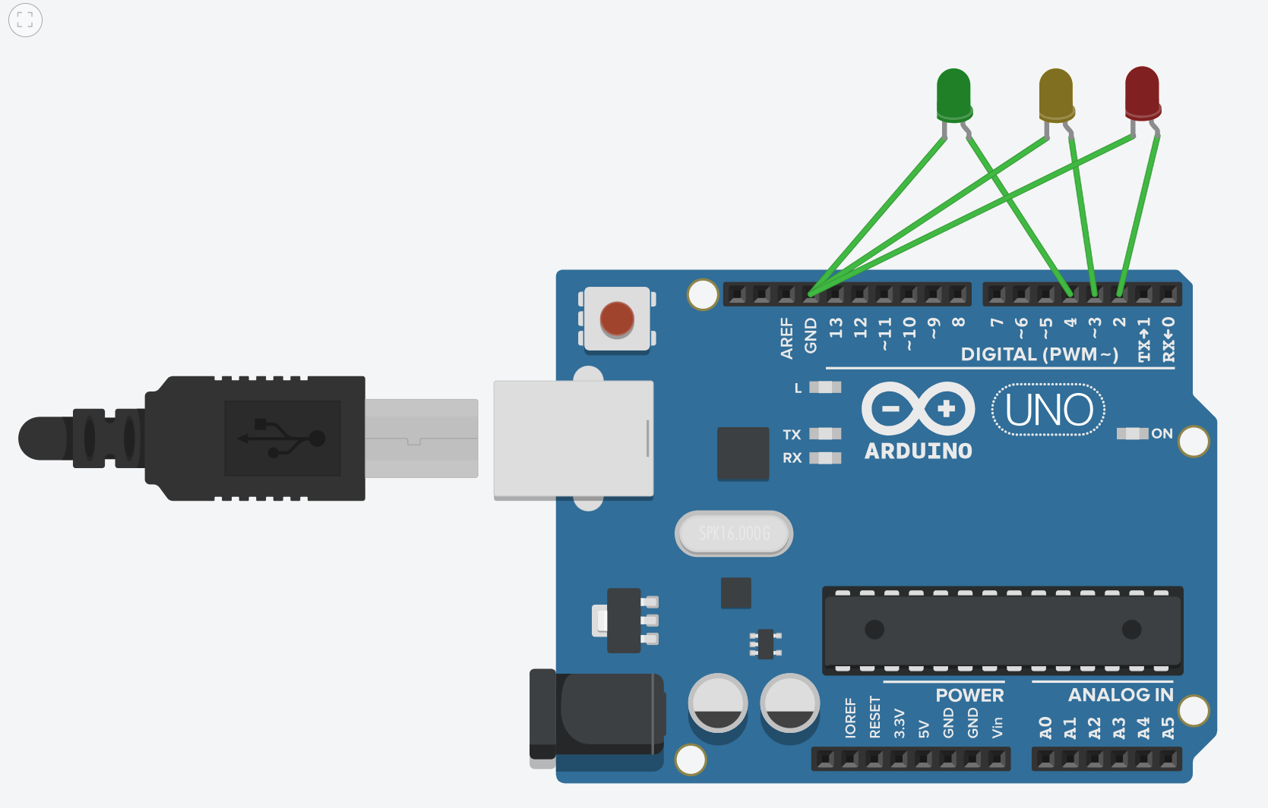

Benefits and Risks
Benefits
Integrating historical traffic data and machine learning algorithms can provide several benefits, such as:
Improved traffic flow and reduced congestion
More accurate predictions of traffic patterns
Increased safety for drivers and pedestrians
Cost savings for transportation agencies
Risks
While there are many benefits to integrating historical traffic data and machine learning algorithms, there are also some risks that should be considered, such as:
Data privacy concerns
Potential biases in the data and algorithms
Dependence on technology that may not always be reliable
Costs associated with implementing and maintaining the technology
Basic circuit design of traffic management using traffic signals

Slide 7
Conclusion
Integrating historical traffic data and machine learning algorithms into an IoT project can provide significant benefits such as improved traffic flow, reduced congestion, and increased safety. However, there are also potential risks such as privacy concerns and the possibility of algorithmic bias. It is important to carefully consider these factors and implement appropriate safeguards to ensure the success and ethical implications of such a project.

